Slide 1
Lab 11. Convolutional Neural Network
Intro to Machine Learning
Fall 2018, Innopolis University

Slide 2
Today's Plan
●Why and What is Keras?
●Installing Keras and TensorFlow
●Fundamentals of Keras
●Understanding Keras Sequential Model
●Building a CNN in Keras (for image recognition) and classification of MNIST using CNN
●Home work

Slide 3
What is Keras
Keras is a high-level python API which can be used to quickly build and train neural networks using either Tensorflow or Theano as back-end.
●Currently, Keras is one of the fastest growing libraries for deep learning.

Slide 4
Why Keras
●Keras is being hailed as the future of building neural networks. Here are some of the reasons for its popularity:
●Light-weight and quick: Keras is designed to remove boilerplate code. Few lines of Keras code will achieve so much more than native Tensorflow code. You can easily design both CNN and RNNs and can run them on either GPU or CPU.
●Emerging possible winner: Keras is an API which runs on top of a back-end. This back-end could be either Tensorflow or Theano. Microsoft is also working to provide CNTK as a back-end to Keras. Currently, the world of Neural Network is very fragmented and evolving very fast.

Slide 5
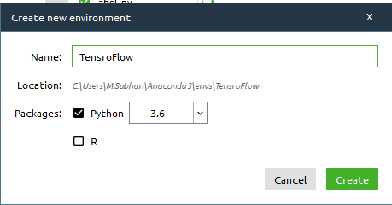
Creating Environment
Open Anaconda Navigator
Go to Environments tab.
Create New Environment

Slide 6
Installing TensorFlow and Keras
pip install tensorflow Or conda install -c conda-forge tensorflow
OR
●To install the TensorFlow library, go to https://pypi.python.org/pypi/tensorflow/1.4.0/ and look for a file named tensorflow-1.4.0-cp35-cp35m-win_amd64.whl.
C:\>pip install C:\Keras\tensorflow-1.4.0-cp35-cp35m-win_amd64.whl

Slide 7
Installing TensorFlow and Keras
●First, install h5py (pip install h5py) for saving and restoring models and other dependencies such as pip install pillow
○https://pypi.python.org/pypi/Keras/2.1.4/
●Look for file Keras-2.1.4-py2.py3-none-any.whl.
●C:\>pip install C:\Keras\Keras-2.1.4-py2.py3-none-any.whl

Slide 8
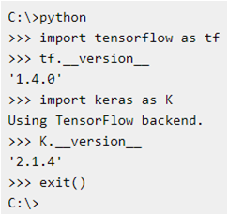
Installing TensorFlow and Keras
●To verify that Python, TensorFlow and Keras have been successfully installed, open a command shell and enter "python" to launch the Python interpreter.
●You'll see the ">>>" Python prompt. Then enter the commands.
●If you see the responses right, congratulations, you're ready to start writing machine learning code using Keras and TensorFlow.

Slide 9
Fundamentals of Keras
●The main data structure in Keras is the model which provides a way to define the complete graph.
●Keras has two distinct ways of building models:
●Sequential models: This is used to implement simple models. You simply keep adding layers to the existing model.
●Functional API: Keras functional API is very powerful and you can build more complex models using it, models with multiple output, directed acyclic graph etc.

Slide 10
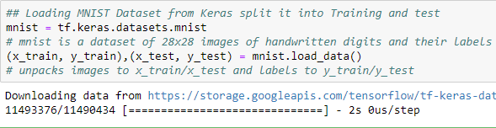
NN for MNIST Image Classification
●Load the Important libraries/packages.
Import tensorflow as tf
Load the dataset.

Slide 11

NN for MNIST Image Classification
● Normalize the Data

Slide 12
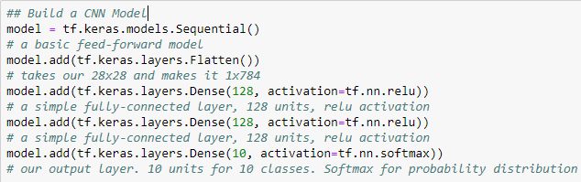
NN for MNIST Image Classification
● Model

Slide 13
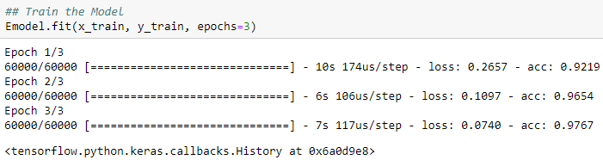
CNN for MNIST Image Classification
● Model Parameters and fit the Model
Notes:
A loss function (or objective function, or optimization score function) is one of the two parameters required to compile a model:
Examples of Optimization function:
1): Stochastic gradient descent (sgd)
2): Adam (the most popular) and Adamax (newer version)
3): RMSProp optimizer
4): Adagrad
5): Adadelta (robust then Adagrad)
6): Nadam
Examples of different loss functions:
1): categorical_crossentropy
2): sparse_categorical_crossentropy
3): binary_crossentropy
There are bunch of other loss functions too, including.
1): mean_squared_error
2): mean_absolute_error
3): mean_absolute_percentage_error
4): mean_squared_logarithmic_error
5): squared_hinge
6): hinge
7): categorical_hinge
8): logcosh
9): kullback_leibler_divergence
10): poisson
11): cosine_proximity

Slide 14


Different Loss Functions
● Categorical cross entropy
● Binary cross entropy
Notes:
The first equation is the definition of cross-entropy when the number of classes is larger than 2. Sparse Categorical Cross-entropy and multi-hot categorical cross-entropy use the same equation and should have the same output. The difference is both variants covers a subset of use cases and the implementation can be different to speed up the calculation.

Slide 15
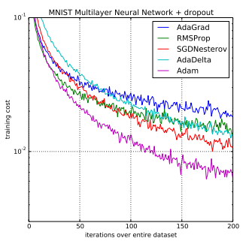
Optimizor
● Adam (adaptive moment estimation)
Default settings for the tested machine learning problems are alpha=0.001, beta1=0.9, beta2=0.999 and epsilon=10−8
http://ruder.io/optimizing-gradient-descent/
Notes:
Adam is an optimization algorithm that can used instead of the classical stochastic gradient descent procedure to update network weights iterative based in training data.
Empirical results demonstrate that Adam works well in practice and compares favorably to other stochastic optimization methods.
Trainable parameters for Adam:
alpha. Also referred to as the learning rate or step size. The proportion that weights are updated (e.g. 0.001). Larger values (e.g. 0.3) results in faster initial learning before the rate is updated. Smaller values (e.g. 1.0E-5) slow learning right down during training
beta1. The exponential decay rate for the first moment estimates (e.g. 0.9).
beta2. The exponential decay rate for the second-moment estimates (e.g. 0.999). This value should be set close to 1.0 on problems with a sparse gradient (e.g. NLP and computer vision problems).
epsilon. Is a very small number to prevent any division by zero in the implementation (e.g. 10E-8).

Slide 16
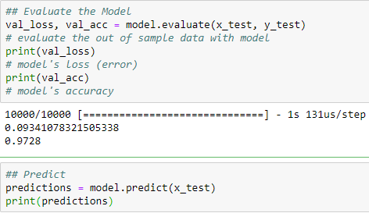
CNN for MNIST Image Classification
● Evaluate the Model

Slide 17
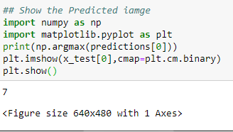
CNN for MNIST Image Classification
● Evaluate the Model

Slide 18
Image Recognition using CNN
Collecting the Dataset
Importing Libraries
Importing Image Datasets
Rescaling Data Set
Saving and reloading the datasets , Splitting the Dataset
Building the CNN
Testing

Slide 19
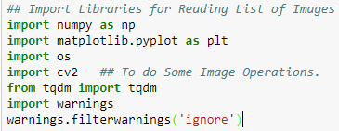
Image Recognition using CNN
○Collecting the Dataset
https://www.microsoft.com/en-us/download/confirmation.aspx?id=54765
○Importing Libraries and Packages

Slide 20
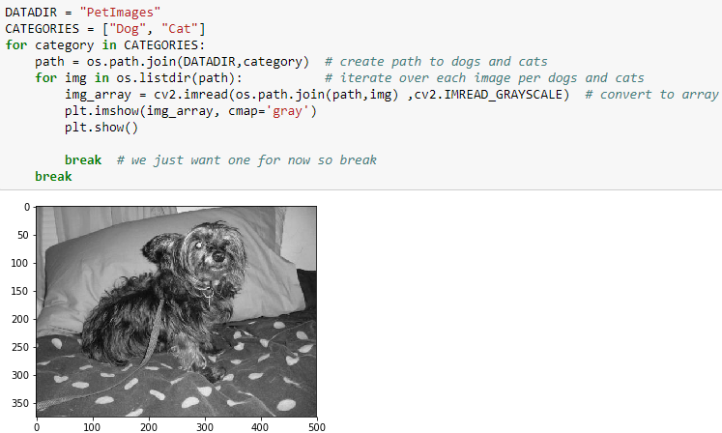
Image Recognition using CNN
○Read and show image

Slide 21
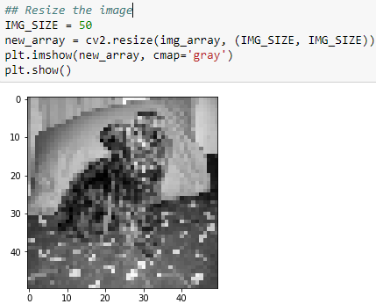
Image Recognition using CNN
○Resize the images

Slide 22
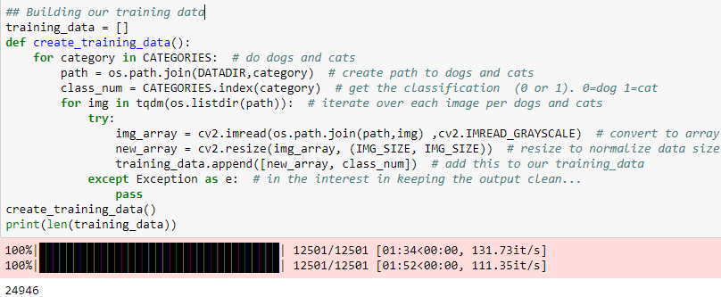
Image Recognition using CNN
○Building training data

Slide 23
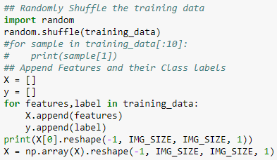
Image Recognition using CNN
○Append Features and their Class labels

Slide 24
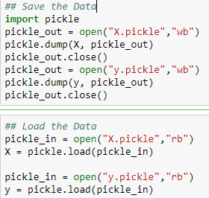
Image Recognition using CNN
○Let's save the data to play with and to reload to the python to train the model

Slide 25
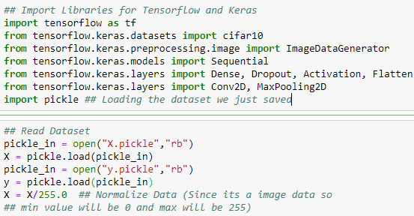
Image Recognition using CNN
○Let's start building CNN model: The basic CNN structure is as follows:
Convolution -> Pooling -> Convolution -> Pooling -> Fully Connected -> Output

Slide 26
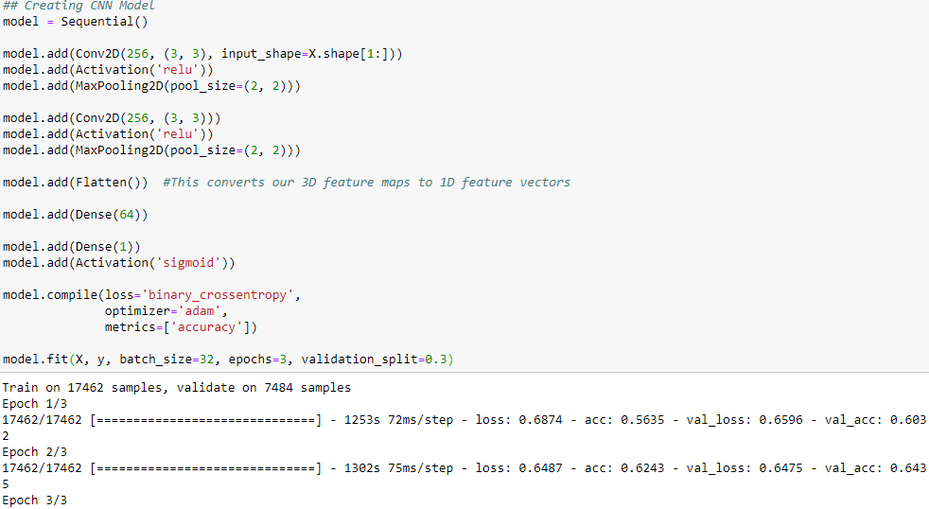
Keras: Sequential Model

Slide 27
Image Recognition using CNN
●Building CNN: This is most important step for our network. It consists of three parts -
○Convolution: The primary purpose of Convolution is to extract features from the input image. Convolution preserves the spatial relationship between pixels by learning image features using small squares of input data.
○Polling: Pooling (also called subsampling or downsampling) reduces the dimensionality of each feature map but retains the most important information.
○Flattening: After pooling comes flattening. Here the matrix is converted into a linear array so that to input it into the nodes of our neural network.

Slide 28
Summary
● The same concept can be applied to a diverse range of objects with a lot of training data and appropriate network. You can change the dataset with the images of your friends and work upon the network to make a Face Recognition Classifier.
●However there are many APIs available which can be automatically embedded into your application. They have been trained on a large dataset.

Slide 29
Homework
There is no specific template for today’s homework. You need to write a rigorous technical report on optimizing the network. The important parameters you need to tune are:
Number of Hidden Layers and Units --- Activation Function --- Number of Epochs --- Batch size --- Different Loss Functions (categorical_crossentropy, sparse_categorical_crossentropy, binary_crossentropy) --- Different Optimization Methods (Stochastic gradient descent (sgd) and Adam).
You are required to write a report (sported with error and Accuracy graphs on above parameters) on which of the following method is appropriate for tuning the parameters with detailed illustration on MNIST dataset. Methods used to find out Hyperparameters are:
1): Manual Search
2): Grid Search
(https://machinelearningmastery.com/grid-search-hyperparameters-deep-learning-models-python-keras/)

